Slide 1
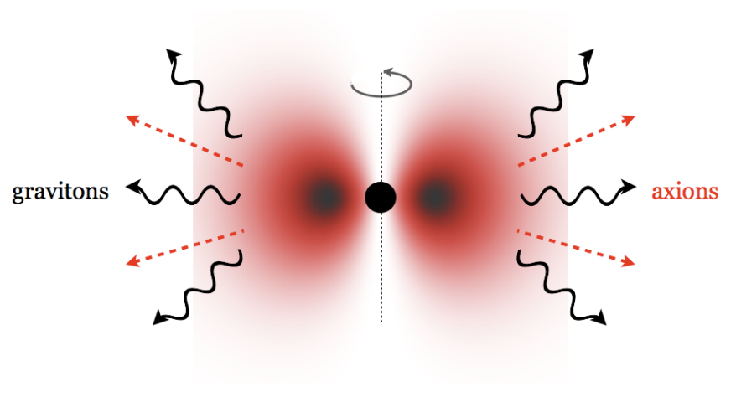
Probing the Non-linear Dynamics of the BH axion System by GWs
Hideo Kodama (KEK)
H Yoshino, H Kodama: CQG [arXiv: 1505.00714]
Ibid: PTEP2015, 061E01(2015) [arXiv: 1407.2030]
Ibid: PTEP2014, 043E02 (2014) [arXiv:1312.2326]
Ibid: PTP128, 153 (2012) [arXiv:1203.5070]
:
“One Hundred Years of Strong Gravity”
@Lisbon IST, 11 June 2015.

Slide 2
Plan of the talk
Axion Cosmophysics
Superradiance Instability of a Rotating BH
Nonlinear dynamics of the BH-axion system
GW emissions and their detectability
Continuous GW search
GW bursts from bosenova
Summary

Slide 3
Axion Cosmophysics

Slide 4
Axion Cosmophysics
  Super-light axionic fields produce a rich variety of new cosmophysical phenomena and provide a new window to string compacitification!!
  Phenomena irrelevant to abundance
  Instabilities of black hole systems
  Influence on high-energy gamma ray propagation
  Solar activity/heat transport
  ……
  Phenomena sensitive to abundance
  Deformation of the cosmological power spectrum
  Rotation of the CMB polarisation
  Dark matter/ Dark radiations
  Dark energy
  ……

Slide 5
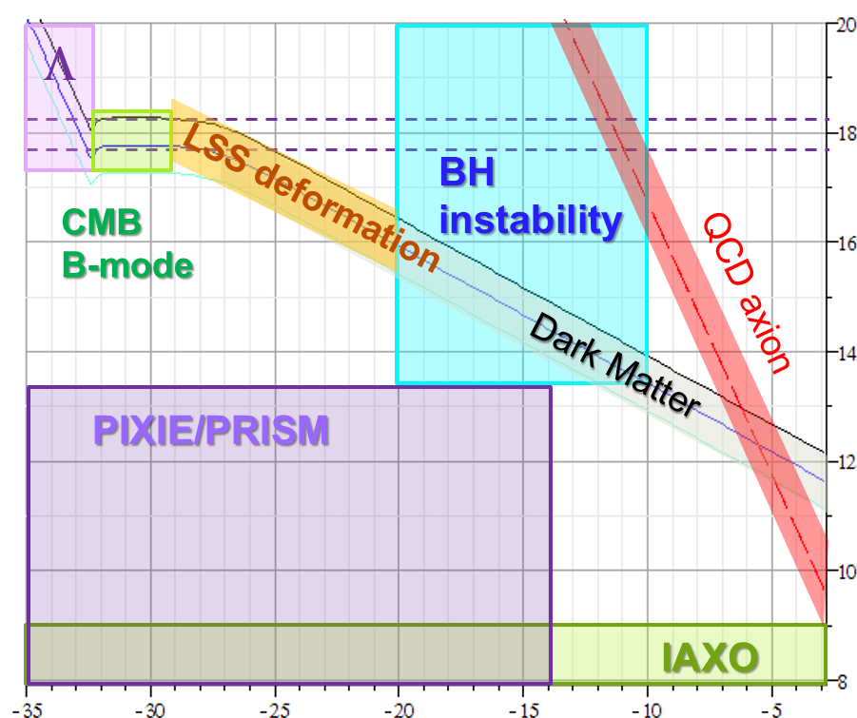


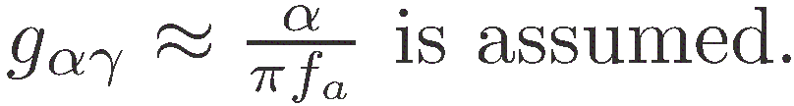
m_{a} – f_{a} plane
String scales

Slide 6
Superradiance instability of a massive scalar field around a rotating BH

Slide 7
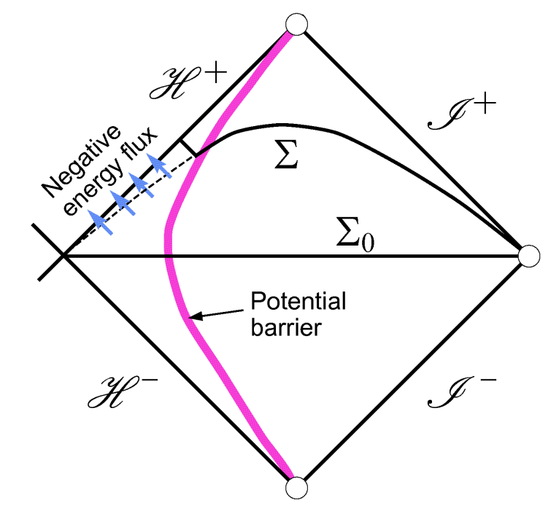
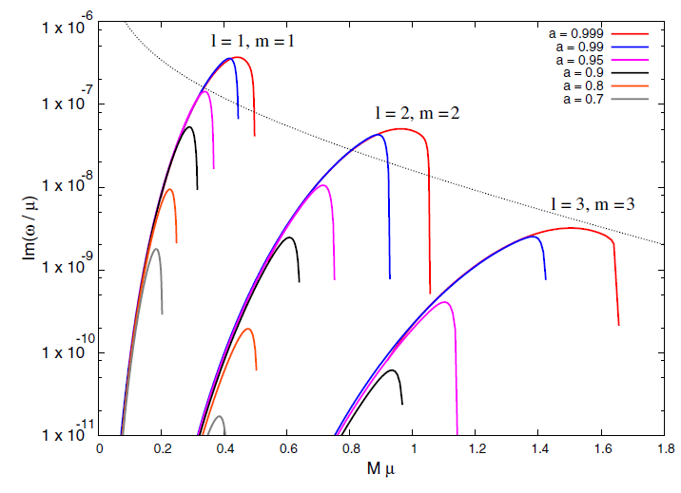

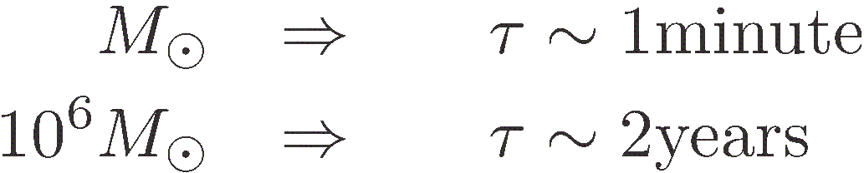
Superradiant Instability of BH
Instability condition
  Massive bosonic fields suffer from instability for bounded modes satisfying
Growth rate for a massive scalar
The growth timescale becomes minimum at
  l=m=1
  a*=a/M ' 0.99
  Mμ » 0.4
For M¸ M☉ , τ can be shorter than the cosmic age when
0.003 < α_{g}=Mμ <20.
Dolan SR(2007)PRD76,084001

Slide 8
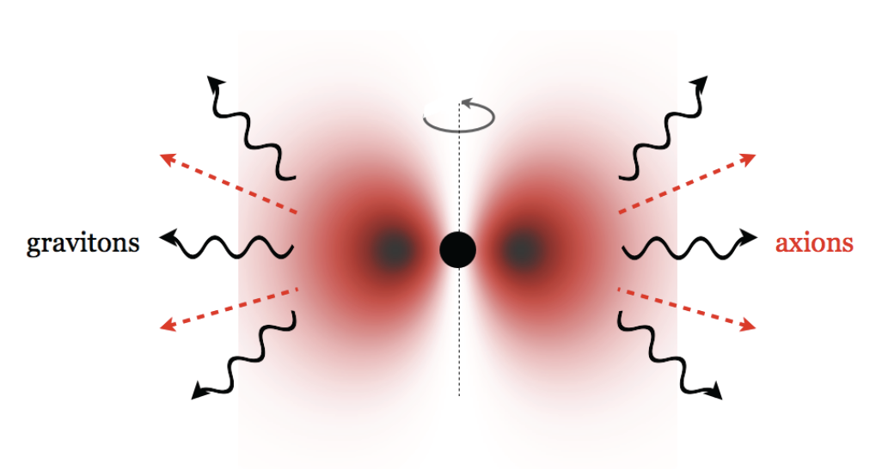
G-Atom
    Arvanitaki A, Dubovsky S: arXiv:1004.3558

Slide 9
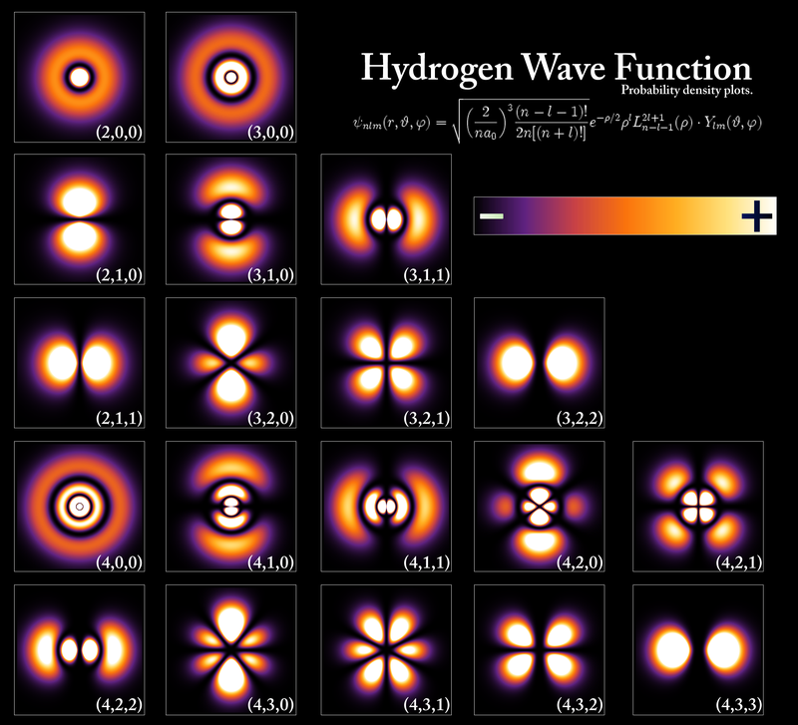
Gravitational Atoms
Unstable bound states are classified by the quantum numbers (n, l, m) exactly as in the case of the hydrogen atom.
Principal quantum number:

Slide 10
SR Instability for Overtone Modes
[H Yoshino, H Kodama: arXiv: 1505.00714]

Slide 11
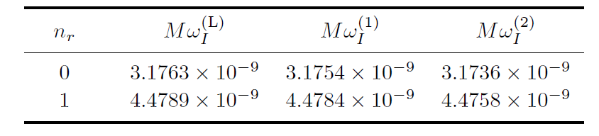
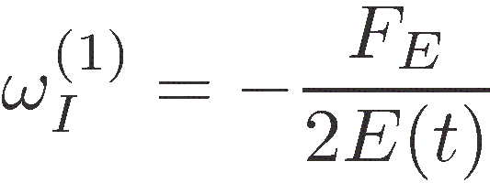
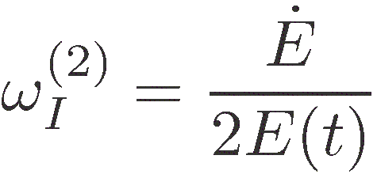
Example: l=m=3, Mμ=1.35, a*=0.99
[H Yoshino, H Kodama: arXiv: 1505.00714]
Leaver method
Energy flux from BH
Energy growth of the axion cloud

Slide 12

Fate of G-Atom?
Axion Cloud
photons
axions
Kerr
BH
Accretion Disk
SR mode
Line
emission
2a → G
Nonlinear self-interaction
Bosenova
Gravitational Waves
Detectable?

Slide 13
Non-linear Dynamics of Axion Clouds and Bose Nova
H Yoshino, H Kodama: arXiv: 1505.00714
Ibid: PTEP2014, 043E02 (2014) [arXiv:1312.2326]
Ibid: PTP128, 153 (2012) [arXiv:1203.5070]
Cf.
H Okawa, H Witek, V Cardoso (2014): prd 89, 104032 [arXiv: 1401.1548]
M Zilhao, H Witek, V Cardoso (2015): arXiv: 1505.00797
Notes:
First, I discuss the evolution of the axion cloud taking account of non-linear self-interactions.
In constrast to these beautiful works which investigated the dynamics
of free massive scalar and proca fields around a black hole by full GR numerical simulations,
we fix the background geometry and do not consider the back reaction of the axion cloud to the geometry.

Slide 14
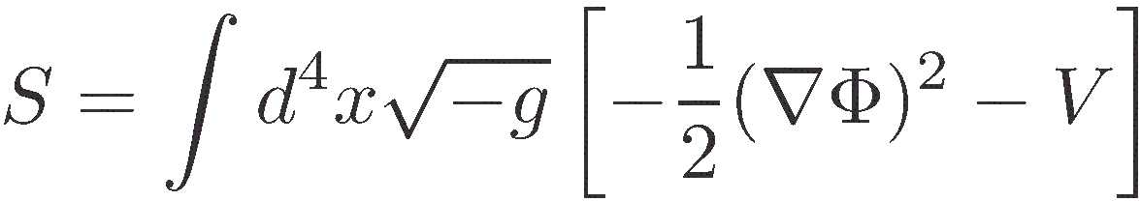
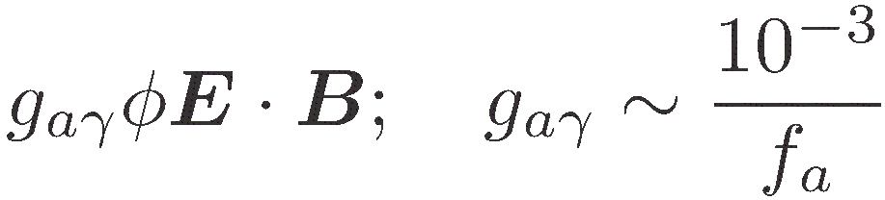
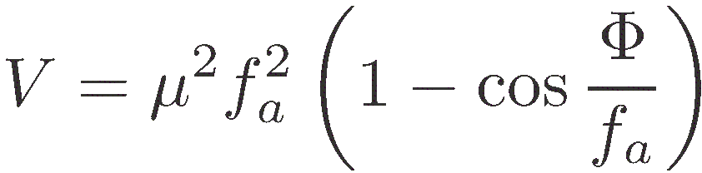
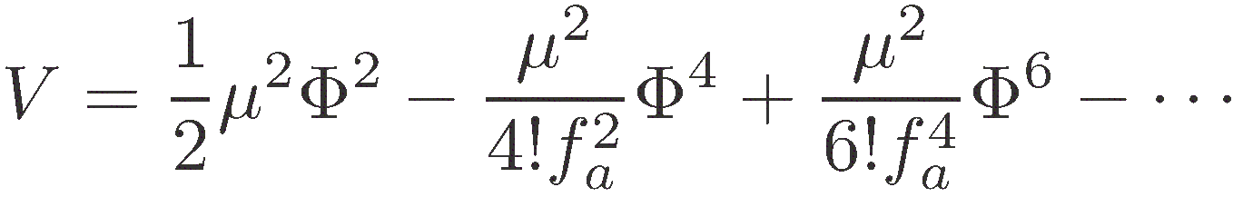
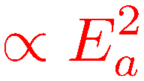
Non-linear Effects
Action of the axion field
γ
q
a
γ₅
γ
axion decay constant
Small field expansion
Attractive interaction!!
Notes:
＊We consider the simplest case in which the axion potential is given by this simple cosine potential.
Here, fa characterises the scale of the axion field and is called the axion decay constant.
In general, the coupling strength of an axion to other field is inversely proportional to fa,
as in the case of the Chern-Simons coupling of the axion to photon by anomaly.
＊When we expand this potential wrt Phi/fa, the leading term is the mass term, and
the next leading term is negative. This term represents an attractive force in proportion to
the square of the axion cloud energy.
＊This suggests that when an axion cloud grows, it may collapse at some stage due to this attractive force.
However, the next-next leading term is repulsive, we have to do numerical simulations to find what really happens.

Slide 15
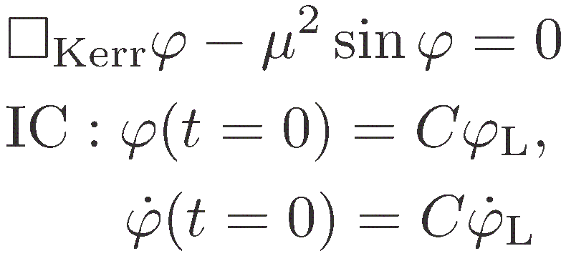
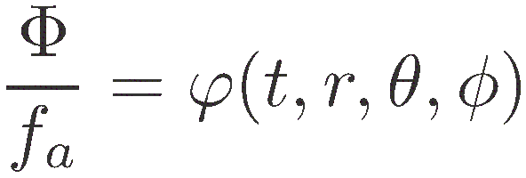
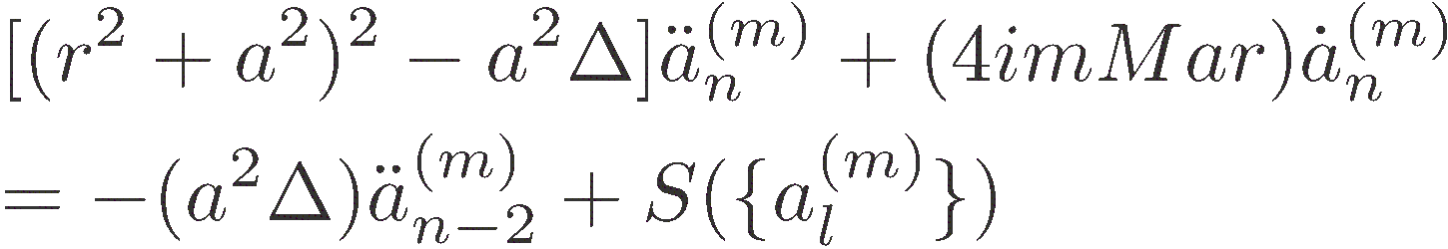
Numerical Methods
Direct 3D simulation code
Pseudo-spectral code
Notes:
＊We did numerical simulations by the following two method.
＊The first one is the direct 3D relativistic simulation in a fixed Kerr BG.
This method is precise and works robustly, but the code is heavy.
＊The second is the pseudo-spectral mehtod in which we expand
the scalar field by powers of exp(i phi) and cos(theta), and
trace the time evolution of a series of coefficient functions of t and r.
The code of this method is light but frequently collapses.

Slide 16
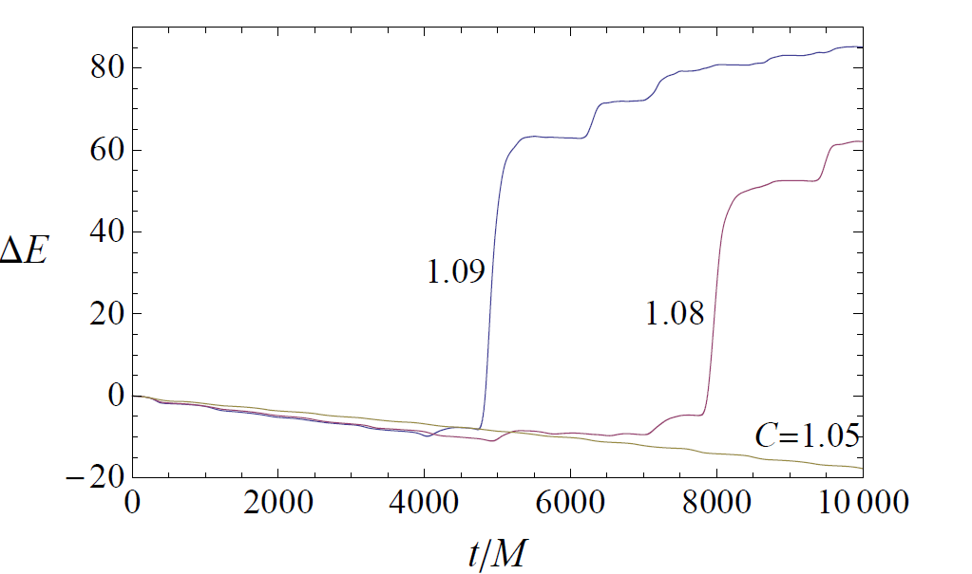
Behavior of the Energy Flux into BH
Our direct 3D simulations reproduced the SR instability growth rate obtained by the Leaver method with sufficient precisions.
l=m=1 case
Notes:
＊First, we show the result on the total energy Delta E (t) absorbed by BH by the time t.
We started from the unstable l=m=1 mode obtained by the Leaver method,
and traced the change of Delta E(t) for various initial amplitudes.
＊When the initial amplitude is small, there happens nothing peculiar during the simulation period,
except that Delta E decreases monotonically. This corresponds to the extraction of the energy
from BH by SR instability. Actually, we have confirmed that the slope conincides with the SR instability
grow rate calculated by the Leaver method with good accuracy.
＊In contrast, when the initial amplitude exceeds some limit, Delta E suddenly increases and becomes positive
at some time. This implies that the SR instability suddenly stopped. We call this phenomenon bosenova.

Slide 17
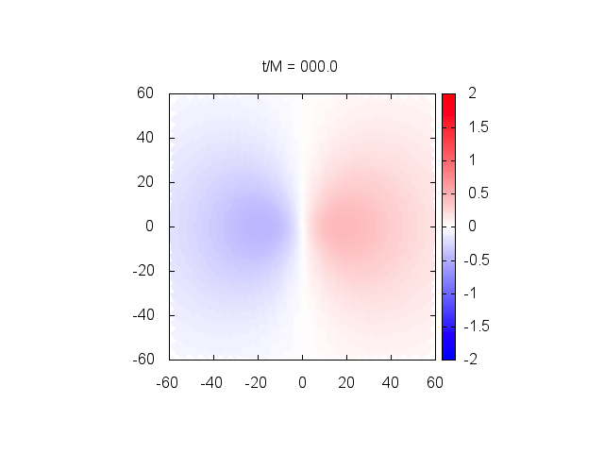
Example of 3D Numerical Simulation: l=m=1
Parameters: a*=a/M=0.99, Mμ = 0.30
Initial mode: pure (l, m, n_{r} ) = (1, 1, 0), Φ/f_{a} =0.４５
Notes:
Now I show a few examples of numerical results.
The first example is the case in which the cloud starts from the l=m=1 fundamental mode.

Slide 18
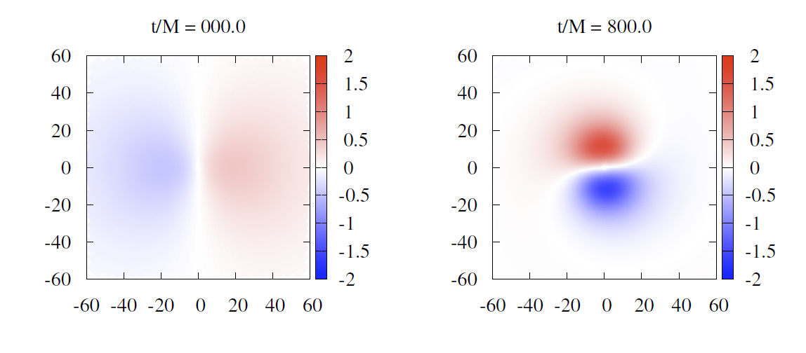
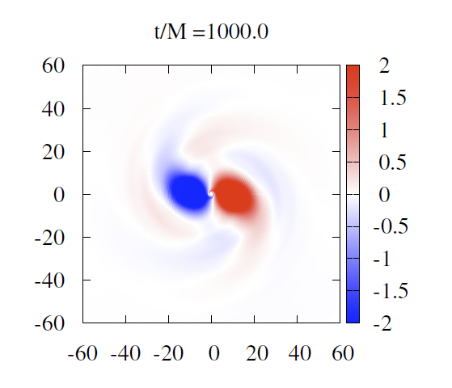
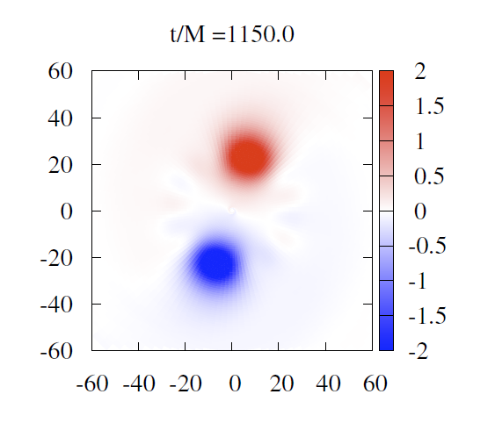
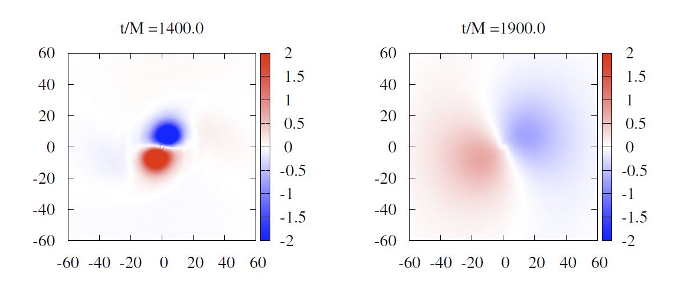

Slide 19
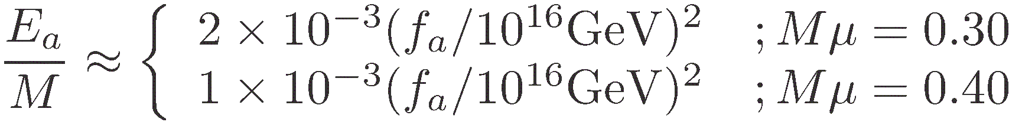

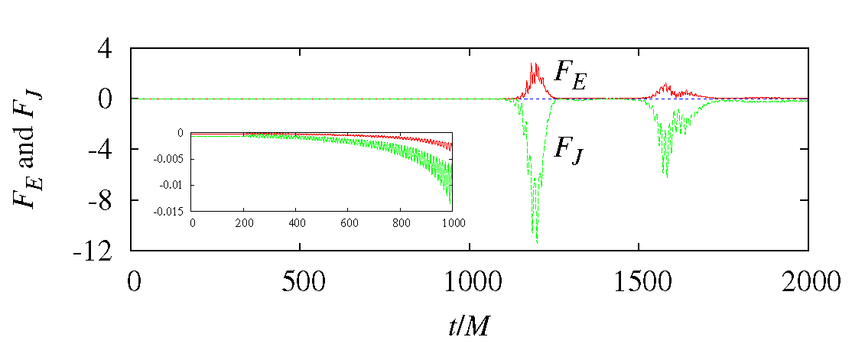
Results
The energy extraction rate from BH by SR instability increases by a factor around 3 due to nonlinear self-interactions.
Bose nova happens when
About 5.9% (Mμ =0.3) and 5.3% (Mμ =0.4) of the total axion cloud mass fall into BH by m=-1 modes excited by non-linear interations.
Notes:
Now, we summarise the main features of the numerical results.

Slide 20
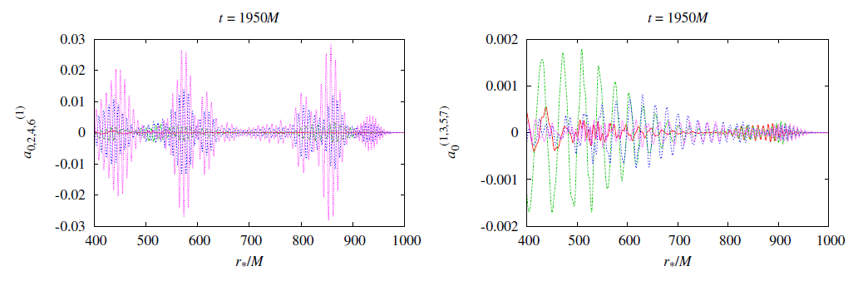
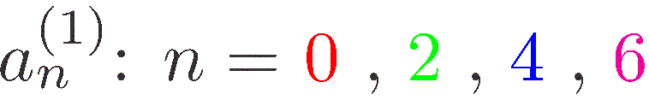
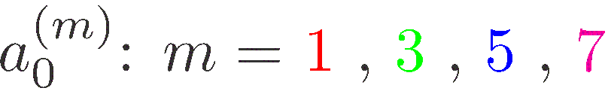
For Mμ =0.3, about 13.4% of the axion cloud mass is ejected to a far region, while for Mμ =0.4, such an outward ejection is negligible.
After bosenova, the axion cloud soon settle down to a new superradiant phase.

Slide 21
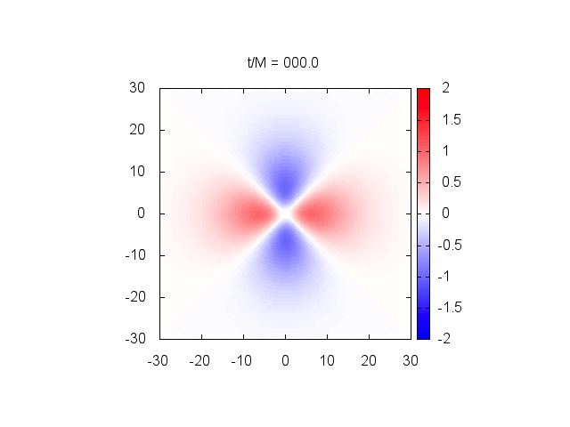
Example of Simulation : l=m=2
Parameters: a*=a/M=0.99, Mμ = 0.80
Initial mode: pure (l, m, n_{r} ) = (2, 2, 0), Φ/f_{a} =1.0
Notes:
Next, we show the result of simulations for the initially l=m=2 mode.

Slide 22
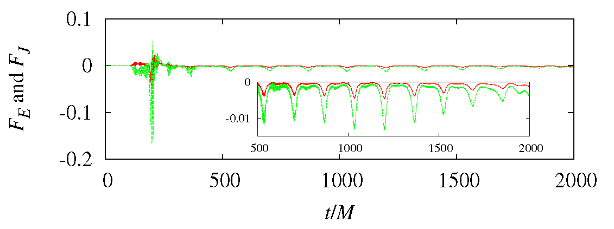
Results
Due to nonlinear self-interactions, the cloud position and shape show periodic modulations, but no violent phenomenon like bosenova happens.

Slide 23
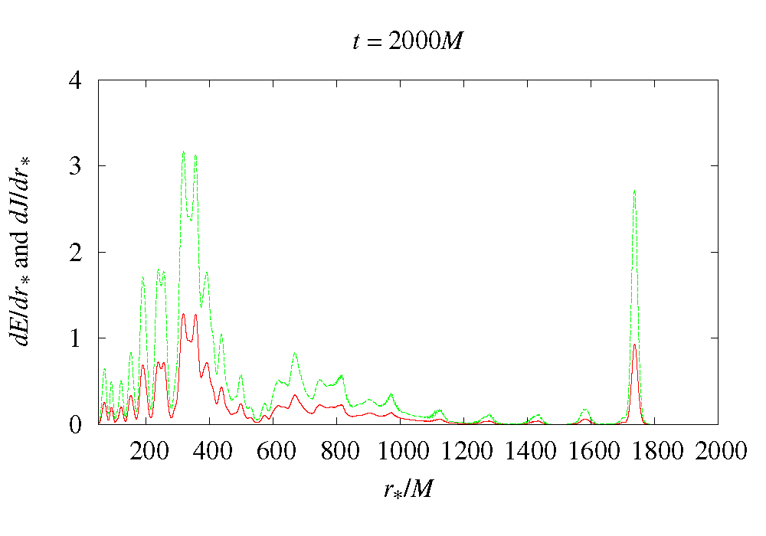
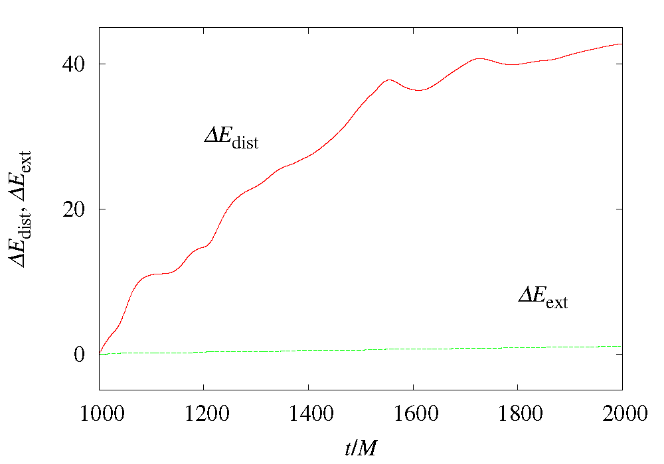
Instead, the cloud continuously lose energy by shedding. Hence, in the realistic setting, the axion cloud stays in a quasi-stationary state with E_{a}/M . 10⁻³ (f_{a}/10¹⁶ GeV)² , for which the SR energy supply and the shedding energy loss (and GW emission) balance.

Slide 24
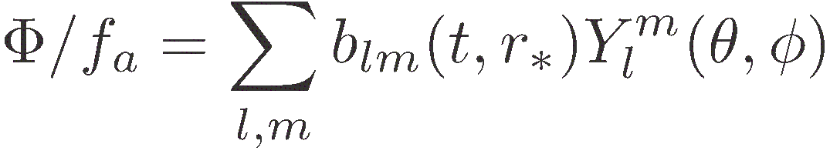
Mode Mixture: l=m=1 + l=m=2
Parameters: a*=a/M=0.99, Mμ = 0.40
Initial mode: (l, m, n_{r} ) = (1, 1, 0)+(2,2,0), Φ/f_{a} =0.7 + 0.01
Notes:
Finally, we talk about the results of a simulation for the initial condition
that is a superposition of l=m=1 mode and l=m=2 mode.

Slide 25
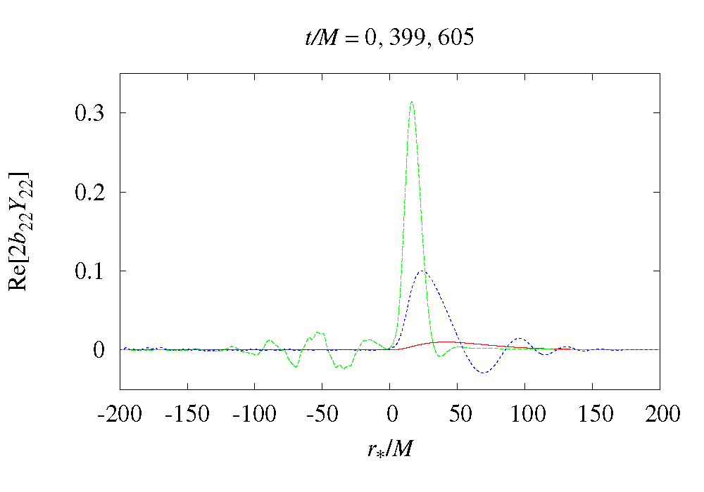
Results
Bose nova happens as in the pure l=m=1 case.
The l=m=2 mode, which is tiny initially, rapidly grows during bosenova due to resonant interactions.
After the bosenova, the l=m=2 components settle down to stationary states but a large fraction of them are unbounded modes.

Slide 26
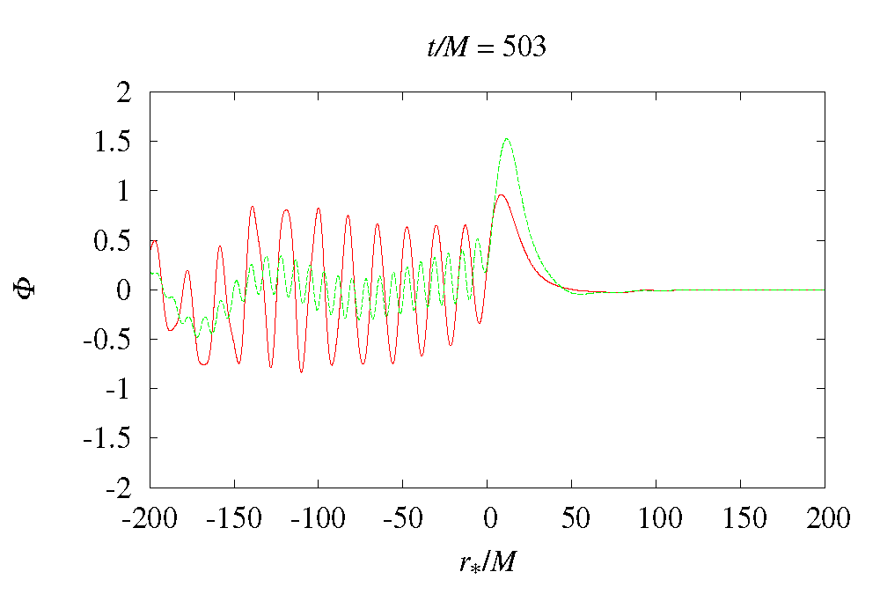
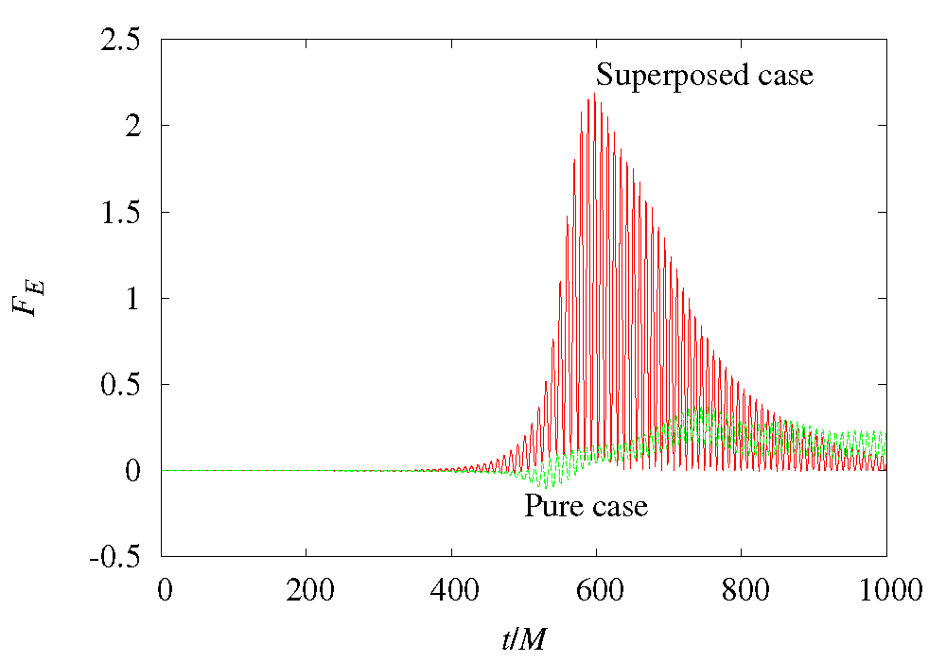
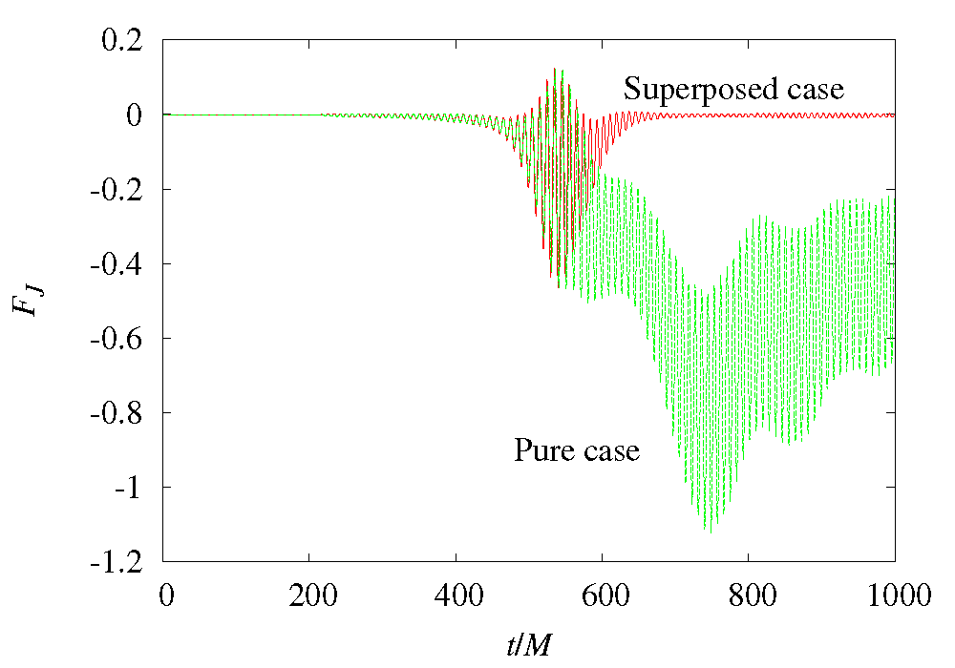
The mixture of a tiny l=m=2 component significantly modifies the shape of the whole wave function, increases the energy infall during bosenova and decreases the angular momentum extraction.

Slide 27
Some Consequences
Mode interactions
  In general, large number of modes may be excited simultaneously because the age of astrophysical BHs are rather long.
  Our multi-mode simulation suggests
  Violent bosenova can be triggered only by the l=m=1 modes.
  l=m>1 modes do not produce violent phenomena, but still periodic bosenova-like phenomena happen.
  The coexistence of these modes with different (l, m) changes the dynamical behavior of the BH-axion system significantly, and in particular, makes bosenova event more violent.

Slide 28
Gravitational Wave Emissions
H Yoshino, H Kodama: arXiv: 1505.00714
Ibid: PTEP2014, 043E02 (2014) [arXiv:1312.2326]
Notes:
Next, we discuss whether we can observe these phenomena around a BH by GWs.

Slide 29



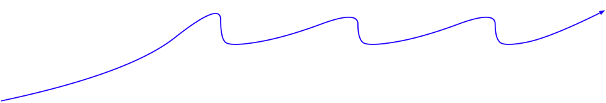


Long-term Behavior of the Axion-BH System
Scalar field amplitude
Bosenova
Bosenova
Bosenova
GW
GW
GW
Superradiant instability
Superradiant instability
Superradiant instability
Superradiant instability
“Gravitational Lighthouse”
Time
Notes:
*For that purpose, first I summarise an overall picture of the evolution of an axion –BH system.
*It starts from a linear growth phase of SR instability and at some time, the first bosnova happens.
After that, superradiant instability phase and bosenova phase appears alternatively.
*Throughout the whole phase, the rotating axion cloud emit continuous GWs nearly constantly.
In addition, burst-type GWs are emitted at bosenova periodically.
*If we can detect these GWs, we can get a definite evidence on the existence of tiny mass axions.
Further, non-detection of such GWs can provide us constraints on the axion parameters.

Slide 30
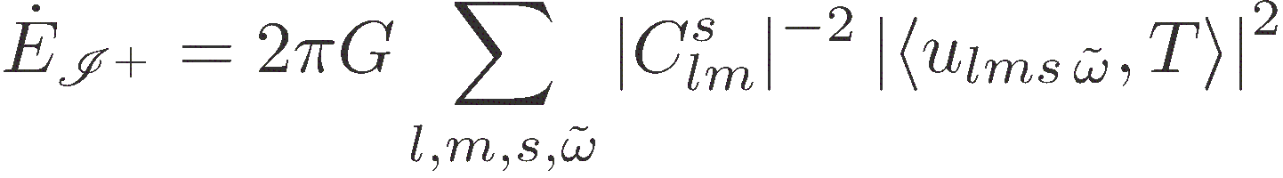
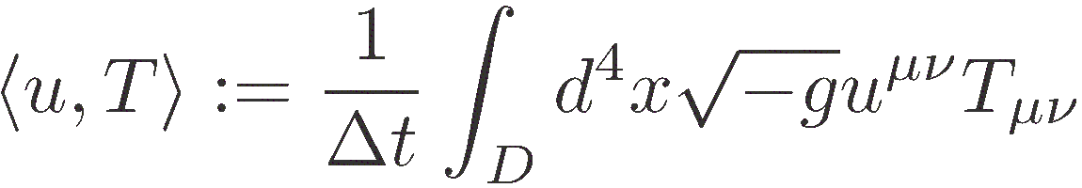
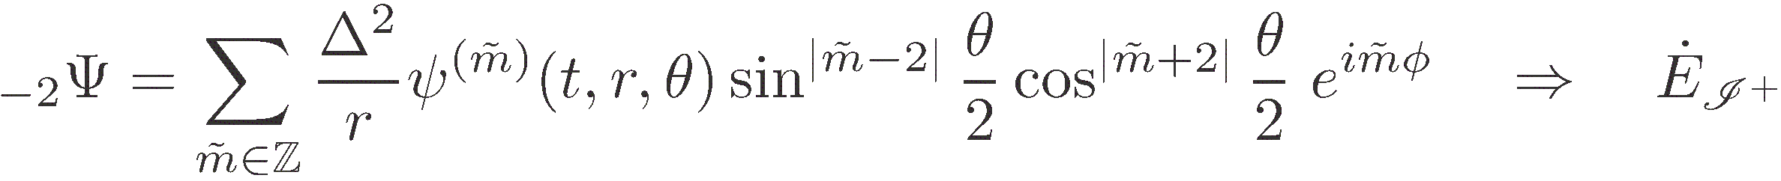
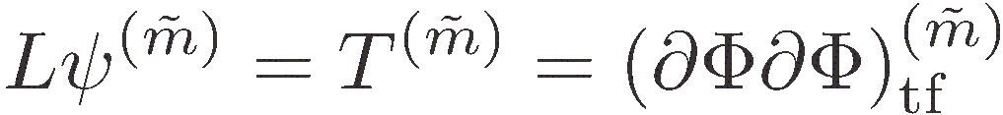
Methods to Estimate GW Emissions
Semi-analytic method based on the Green’s formula and the separation-of-variable solution of the source-free Teukolsky equation
Numerical integration of the Teukolsky equation in the time domain.
Notes:
*In order to estimate these GW emissions, we have used two methods.
*The first one is a semi-analytic method based on …
The energy flux to infinity can be obtained by just integrating the product of the
source-free GW solution and the EM tensor of the scalar field obtained by numerical simultions.
*The second method is to solve the Teukolsky equation with source term in the time domain.
The GW energy flux is obtained by the standard formula for the energy flux in term of the Teukolsky
function.

Slide 31
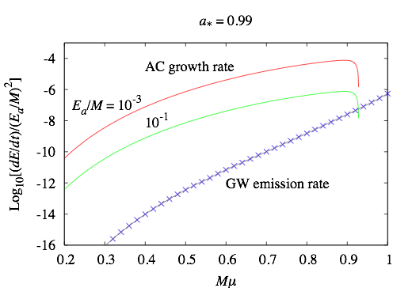
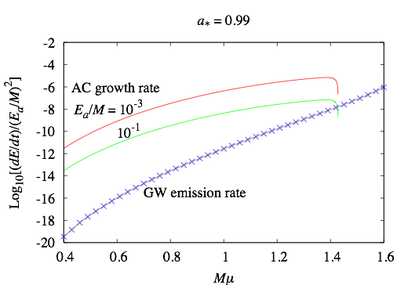

Does GW emissions stop SR instability ?
GW emissions do not hider the occurrence of the bose nova collapse!!
L=m=2 mode
L=m=3 mode
Notes:
*The first question we addressed is whether GW emission stops the SR instability.
*These figures show the energy loss rate by GW emission and the energy gain rate by SR imstability
in units of (Ea/M)^2 as funcitions of M mu for l=m=2 and 3.
We see that the SR energy gain is much larger than the GW energy loss in the parameter region
where the SR instability is effective.
*Hence, GW emissions to not hider the occurrence of bose nova collapse.

Slide 32
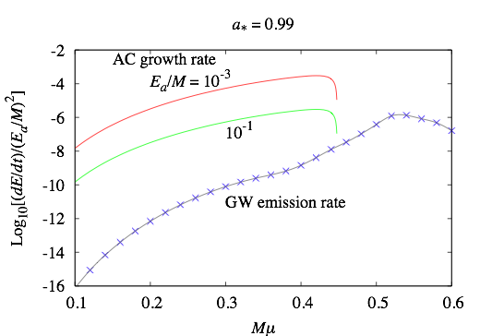
The GW emission rate by the 2 a -> G process of the l=m=1 mode can become 100 times that of the quadrupole formula !!
L=m=1 mode
Notes:
The same is true also for l=m=1 modes, but for this mode, as a byproduct,
we find that the GW emission rate ….

Slide 33
Continuous GW Search for Cygnus X-1
H Yoshino, H Kodama: PTEP2015, 061E01(2015) [arXiv: 1407.2030]

Slide 34
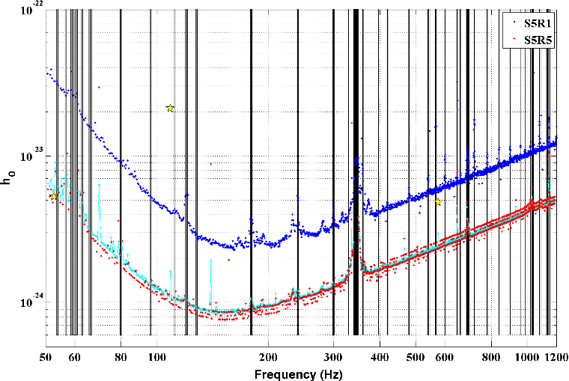
Continuous GW Search by LIGO
PRD87, 042001 (2013)
Notes:
The continuous GW search has been done by LIGO for GWs from deformed pulsars.
Now, let us see whether we can use the result of this search for continuous GWs from axion clouds inside of our galaxy.

Slide 35





Basic Idea
Consider continuous waves from BH-axion system
We assume , hence
We consider an axion cloud in the l = m = 1 mode.
We use the approximate formula for small
The wave form is the same as the distorted pulsar case
Amplitude:
Notes:
LIGO is sensitive in this frequency range.
Because the frequency of continuous GWs from the axion is about twice the axion mass,
the relevant mass range is …..

Slide 36
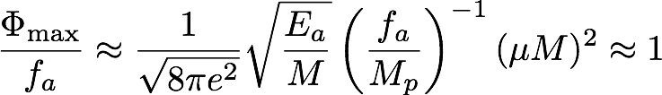

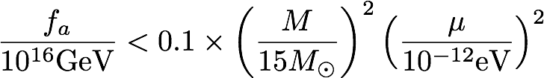
As E_{a}, we adopt the value when the nonlinear self-interaction becomes important:
In order to exclude the situation where gravitational backreaction is significant, we require

Slide 37




Cygnus X-1
McClintock, et al., arXiv:1106.3688-3690{astro-ph}
Notes:
This figure shows the constraint on the axion mass and axion decay constant obtained by this method for the Cygnus X-1.

Slide 38

Subtleties in Matched Filtering
The method of continuous GW search from deformed pulsars by LIGO cannot be directly applied to our case because isolated pulsars are assumed in their analysis:
  Modulation due to the orbital motion of Cygnus X-1
  Modulation due to non-linearity of the axion cloud.
These modulations can be precisely determined by using the results of our direct numerical simulations, and at the same time, they can be smoking gun features to discriminate GWs from the Cygnus X-1 from GWs from deformed pulsars.
The time variation of a GW amplitude for the
l=m=1 simulation

Slide 39




Constraints in the a*-α plain: Cyg X-1
f_{a}=10¹⁶GeV: M=15 M☉, t=5x10⁶ yrs
forbidden
allowed
LIGO range
Solid line: t=t_{BN}, Dashed line: t=t_{a*}, Dotted line: L_{disk}> L_{eddington}
Notes:
*In addition to these subtleties, there is a serious obstruction against the realisation
of bosenova in the Cygnus X-1 and its observation. It is the spin down of the BH.
*In this a_*-alpha plane, the timescale for the first occurrence of bosenova is equal to the age of the Cygnus X-1, around 5 million years,
on the solid curve for each unstable mode.
*Hence, naively speaking, bosenova happens in the parameter region above solid curves.
*In reality, however, in the region above the dashed curves, a_* decreases significantly within the age of the Cygnus X-1.
Of course, there is a possibility that the angular momentum supply by the accretion disk may compensate the
angular momentum loss by superradiance.
*This compensation can not realised in the region above the dotted curves where the required disk luminosity becomes larger
than the Eddington luminosity.
*Hence, assuming the a_*=0.9 for the Cyg. X-1, the range of alpha_g shown by a thick red line is forbidden for f_a= 10^16 GeV.
There remains a small allowed range, the corresponding GW frequency is out of the LIGO range.

Slide 40

f_{a}=5x10¹³GeV: M=15 M☉, t=5x10⁶ yrs
allowed
forbidden
allowed
LIGO range
Solid line: t=t_{BN}, Dashed line: t=t_{a*}, Dotted line: L_{disk}> L_{eddington}
Dashdotted line: t=t_{a*} (no bosenova case)
Notes:
*The situation becomes better for smaller values of fa.
*For example, for fa =5x10^13 GeV, there exists a range of the axion mass for which bosenova happens and
the emitted frequecy of GWs is in the LIGO range.
*However, to detect GWs for this value of the axion decay constant, the amplitude of continuous GWs is
too small.
*Now, we point out that the GW burst from bosenova may resolve this problem.

Slide 41
GW Bursts from Bosenova – preliminary calculation –
H Yoshino, H Kodama: arXiv: 1505.00714

Slide 42




Method of Calculation
Preliminary Calculation in the Schwarzschild Background
Time Domain Teukolsky Eq.
Notes:
*We are now calculating burst-type GW emissions from bosenova
by using the time-domain method I mentioned before.
*Up to now, we have only finished calculations for a slightly artificial situation in which
we first study the non-linear evolution of an axion cloud starting from a large amplitude
initial condition in the Schwarzschild BG and calculate GW emissions from that system.
Hence, the result is preliminary, but we believe that the result does change significantly
even in the Kerr background.

Slide 43

GWs from a Strongly Nonlinear Cloud
Schwarzschild Background: l=m=1, n_{r}=0, Φ_{peak}/f_{a} = 0.5
Bosenova happens around t=800M as in the Kerr BG case.
Notes:
We show just one example.
In this example, the initial condition is given by the fundamental mode for l=m=1 with amplitude 0.5.
Even in the Schwarzschild background, a bosenova happens for this system around t=800M as in the Kerr BG.

Slide 44

Around the time of bosenova, burst-type GWs are emitted. Their amplitude amounts to more than 10⁴ times that during the SR phase!!
Notes:
*These figures show the (m=2) componet of the GW amplitude as function of the radius for four different times.
*These figures clearly show that

Slide 45

The amplitude of GW grows exponentially around the bosenova collapse and reaches 10⁴ times the initial amplitude.
Notes:
From the time behavior of the (m=2) GW component at r_*=200M,. we confirm that

Slide 46


Constraints in the a*-α plain: Massive BH
f_{a}=10¹⁵GeV: M=10⁶ M☉, t=cosmic age
forbidden
allowed
allowed
LISA range
Solid line: t=t_{BN}, Dashed line: t=t_{a*}, Dotted line: L_{disk}> L_{eddington}
Notes:
Finally, we note that this burst-type GWs from Sgr. A*, the intermediate massive BH at the center of our Galaxy
may be detected. In fact, the time scale constraint in the a*-alpha plane is weaker than that for the Cyg. X-1, and
bosenova by a l=m=1 mode can happen if the axion decay constant is around 10^15 GeV and
the axion mass is around 10^-17 eV.

Slide 47




Bosenova GWs from Sgr A*
Sagittairus A*
LISA sensitivity curve
Notes:
The strain amplitude of the burst-type GW from such a bosenova is estimated to be around 10^-17 Hz^-1/2.
Hence, according to the design sensitivity curve of LISA, such GWs can be detected by the future experiments
such as eLISA or DECIGO if such bosenova happens.

Slide 48
Summary

Slide 49
Summary
Superradiant instability and non-linear self-interaction of (psuedo)scalar fields around rotating BHs produce quite rich and energetic phenomena, if the axion mass m_{a} and the BH mass M satisfy the condition 0.01 . GMm_{a} . 5.
GW emissions from these phenomena can be detected by the ongoing and planned GW interferometers such as LIGO, KAGRA and the advanced LIGO, if they happen inside our galaxy or in nearby galaxies.
This approach provides us with a unique method to probe the large f_{a} region of string axions.

