Slide 1
Graviton Oscillation in a viable bigravity model
Takahiro Tanaka (Kyoto University)
Based on
PTEP2014 043E01 De Felice, Nakamura and TT
JCAP 1406 (2014) 004 Yamashita and TT
JCAP1406 (2014) 037 De Felice, Gumrukcuoglu, Mukohyama, Tanahashi and TT
Int. J. Mod. Phys. D23 (2014) 1443003 Yamashita, De Felice and TT
Phys. Rev. D91 (2015) 062007 Narikawa, Tagoshi, TT, Kanda and Nakamura

Slide 2
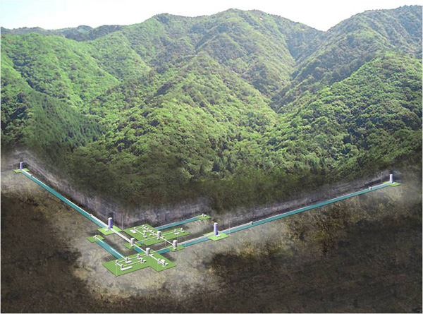
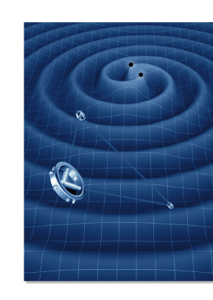
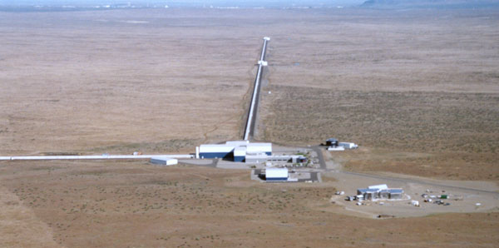
Gravitation wave detectors
TAMA300,CLIO
⇒KAGRA
eLISA(NGO)
⇒DECIGO/BBO
LIGO⇒adv LIGO

Slide 3
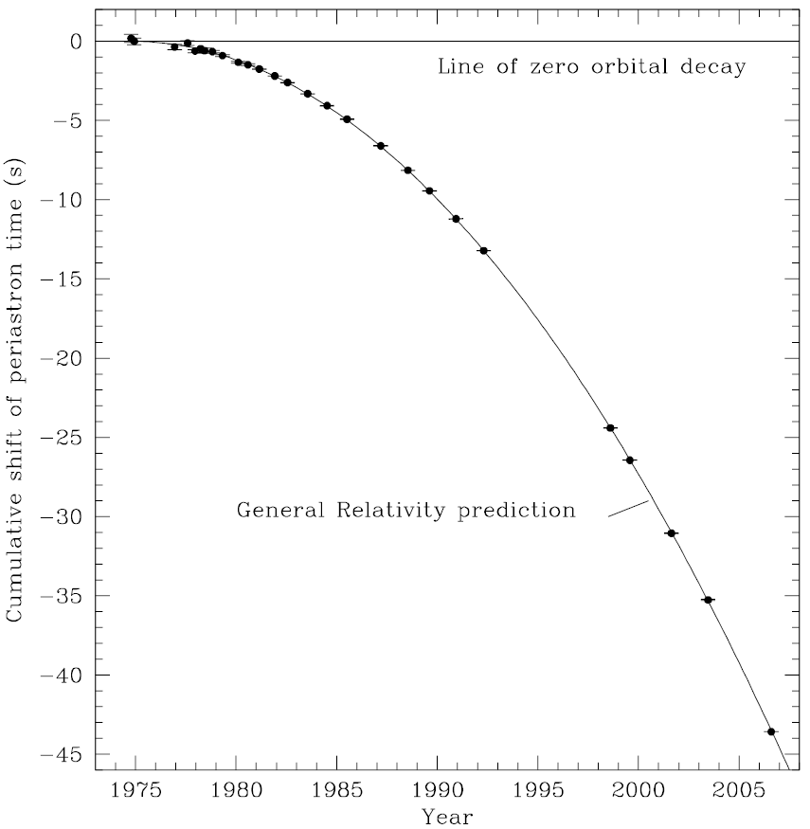
Test of GW generation
Pulsar : ideal clock
Periastron advance due to GW emission
PSR B1913+16
Hulse-Taylor binary
dP_{orb}/dt=−2.423×10⁻¹²
Agreement with GR prediction
Test of GR by pulsar binaries
（J.M. Weisberg, Nice and J.H. Taylor, arXiv:1011.0718)

Slide 4
We know that GWs are emitted from binaries.
What is the possible big surprise when we directly detect GWs?
Is there possibility that graviton disappear during its propagation over cosmological distance?

Slide 5
Bi-gravity
Both massive and massless gravitons exist.
→ν oscillation-like phenomena?
First question is whether or not we can construct a viable cosmological model.

Slide 6
Ghost free bi-gravity
~
g is promoted to a dynamical field.
Even in this case, it was shown that the model remains to be free from ghost.
(Hassan, Rosen (2012))

Slide 7
FLRW background
(Comelli, Crisostomi, Nesti, Pilo (2012))
branch 1
branch 2
branch 1：
Pathological: At the linear perturbation, expected scalar and vector perturbations are absent. Strong coupling? Unstable for the homogeneous anisotropic mode.
branch 2：
Healthy: All perturbation modes are equipped.

Slide 8
Branch 2 background
branch 1
branch 2
branch 2：
ξ becomes a function of ρ.
ξ → ξ_{c} for ρ →0.
effective energy density due to mass term
Natural Tuning to c=1 for ρ → 0.
Effective gravitational coupling is weaker because of the dilution to the hidden sector.

Slide 9
Stability of linear perturbation
Gradient instability
Healthy branch
Higuchi ghost
JCAP1406 (2014) 037 De Felice, Gumrukcuoglu, Mukohyama, Tanahashi and TT

Slide 10
Gravitational potential around a star
(PTEP2014 043E01 De Felice, Nakamura and TT)
Spherically symmetric static configuration:
Erasing , and truncating at the second order
can be tuned to be extremely large.
Then, the Vainshtein radius
can be made very large, even if μ ⁻¹ << 300Mpc .
Solar system constraint:
~
Both v and v are excited as in GR.

Slide 11
Meaning of c >>1
Gradient instability
Healthy branch

Slide 12
Gravitational wave propagation
Short wavelength approximation：
(Comelli, Crisostomi, Pilo (2012))
k_{c}
mass term is important.
c ≠１ is important.
k
Eigenmodes are
Eigenmodes are
modified dispersion relation due to the effect of mass
modified dispersion relation due to different light cone

Slide 13
Gravitational wave propagation over a long distance D
Phase shift due to the modified dispersion relation:
becomes O(1) after propagation over the horizon distance
1.0
0.5
δ Φ₂
log₁₀x
-
2
-
1
1
2
-
0.5
κ =0.2
δ Φ₁
κ =1
-
1.0
κ =100
-
1.5

Slide 14
At the GW generation, both and are equally excited.
X
k_{c}
k
Only the first mode is excited
Only the first mode is detected
X
We can detect only h.
Only modes with k～k_{c} pick up the non-trivial dispersion relation of the second mode.
Interference between two modes
Graviton oscillations
If the effect appears ubiquitously, the model would be already ruled out.

Slide 15
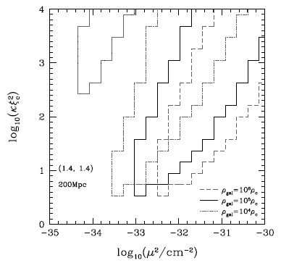
Gravitational wave oscillations
B
κξ ² =0.2
4
κξ ² =1
κξ ² =100
B₁
2
Detectable range of parameters by KAGRA, assuming NS-NS binary at 200Mpc.
log₁₀x
B₂
-
2
-
1
1
2
-
2
-
4
At low frequencies only the first mode is excited.
At high frequencies only the first mode is observed.
(Phys. Rev. D91 (2015) 062007 Narikawa, Tagoshi, TT, Kanda and Nakamura)

Slide 16
If Vainshtein mechanism works for GW detectors…
At the GW generation, both and are equally excited.
X
k_{c}
k
Only the first mode is excited
X
Only the first mode is detected
X
We detect both and .
All modes with k > k_{c} pick up the non-trivial dispersion relation of the second mode.
～
Interference between two modes
Graviton oscillations

Slide 17
Solar system constraint:
For detection by aLIGO, aVirgo and KAGRA:
No Vainshtein effect in the inter-galactic space:
Window is narrow but open.
Bare mass:
Gradient instability
Cosmological solution
disappears

Slide 18
Can Bigravity with large C be naturally realized as a low energy effective theory?
KK graviton spectrum
Only first two modes remain at low energy
Higher dimensional model?!
Matter on right brane couples to h.
If the internal space is stabilized
However, pinched throat configuration looks quite unstable…

Slide 19
Induced gravity on the brane
Dvali-Gabadadze-Porrati model (2000)
Induced gravity terms play the role of potential well.
Lowest KK graviton mass
KK graviton mass
Critical length scale
??
Δ y
Brane
Minkowski
Bulk
Brane
is required to reproduce bigravity.

Slide 20
(JCAP 1406 (2014) 004 Yamashita and TT)
To construct a viable model, the radion (=brane separation) must be stabilized.
Radions can be made as heavy as KK gravitons.
However, the stabilization energy scale cannot be made large.
We know that self-accelerating branch has a ghost.
Normal branch condition:
cannot be made larger
than in this model.

Slide 21
Summary
Gravitational wave observations give us a new probe to modified gravity.
Even graviton oscillations are not immediately denied, and hence we may find something similar to the case of solar neutrino experiment in near future.
However, natural realization of such a scenario is not easy to obtain.

